Slide 1

How Long Will a Customer Reserve a Space?
Ben Chapdelaine, Adam Chappell, Michael Friedman, Tausha Morris

Slide 2
Introduction:
What: Prediction
Why: Greater profits, efficiency, and customer satisfaction
Stakeholders: Clients providing the storage space, Neighbor Leadership, Investors

Slide 3
Data Background:

Slide 4
Data Background:
6 Data Tables
1300+ Observations
35 Predictors
Variables of Interest
Storage Type
Discount
When The Space Was Posted
Price Per SQFT
Notes:
Most variables are binary so sum stats aren’t super helpful

Slide 5
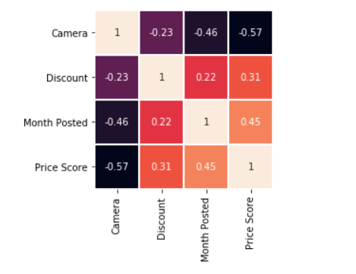
Correlations of Top 4 Predictors

Slide 6
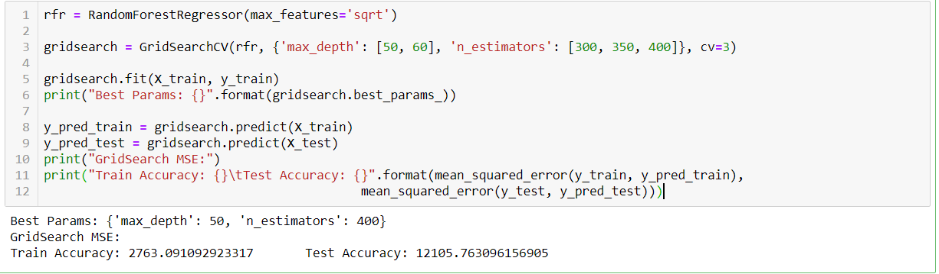
Methods: Random Forest:
Justification - why did we use it?
Does not make any assumption about the functional Form
Not concerned with causality, only prediction. Interpretability is not a concern.

Slide 7
Methods: Lasso CV
Justification - why did we use it?
Helps with overfitting
Not sure what are the best predictors
Not interested in causal relationship, just predictions: therefore throwing out variables OK

Slide 8
Results:
GridSearch MSE:
Train Accuracy: 2763.09
Test Accuracy 12105.76
Our results are overfitted and haven’t figured out what to change to improve our results

Slide 9
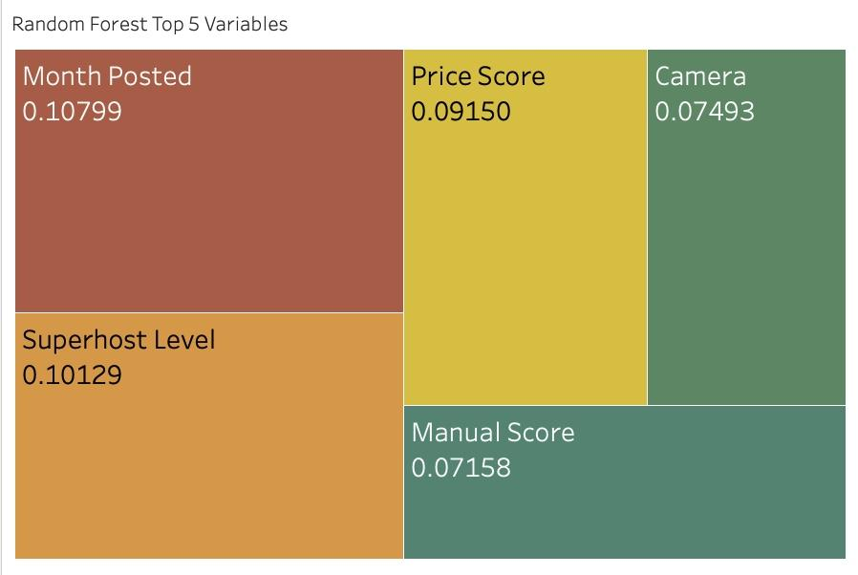
Results:

Slide 10
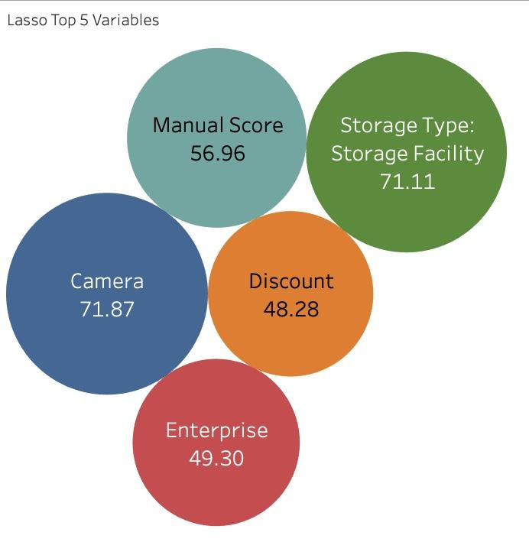
Results:

Slide 11
Conclusion:
Supply and Demand of Storage
Hosts can plan ahead for Renter

